Slide 1
Natural Language Processing: Using Adverse Event Text to Predict if Patient is Injured Due to the Device Malfunction
Mindy Wang

Slide 2
Definition of the problem

Slide 3
The are many medical device malfunctions each year. When a device malfunctions, there is an adverse event that they need to report to FDA. Some of the malfunctions have caused injury and some have not. I would like to see if we can predict injury with the AE report text. We hope we can help prevent patients from injury in the future.

Slide 4
About the data

Slide 5
MAUDE - Manufacturer and User Facility Device Experience from Open FDA
[MADUE] https://www.accessdata.fda.gov/scripts/cdrh/cfdocs/cfmaude/results.cfm
500 records of adverse events reported from 01/01/2020 to 05/31/2023

Slide 6
Hypothesis

Slide 7
This is a dataset of 500 from FDA in Adverse Event Report text on medical device malfunctions.
Train/test Split of 80/20
Use the AE text with NLP to predict if the malfunctions cause injury or not.
Evaluate the accuracy, precision, and recall.
Dependent variable: injury.
Independent variable: AE report text.

Slide 8
Methods to test the hypothesis

Slide 9
EDA
Text data pre-processing, including change the text to lower case, remove punctuations, remove stop words, lemmatize the text, tokenization, etc.
Create words count for graph and word cloud.
Use Multinomial NB to predict injury or not.
In the future, use topic modeling to identify topics in the text.

Slide 10
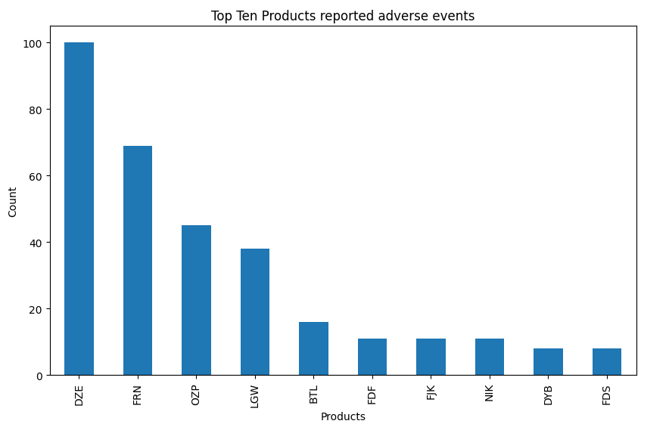
Note: This chart is based on the raw number of reported adverse events. We don’t have the number of the devices in circulation. The device that reported more adverse events is not an indication of unsafe device.

Slide 11
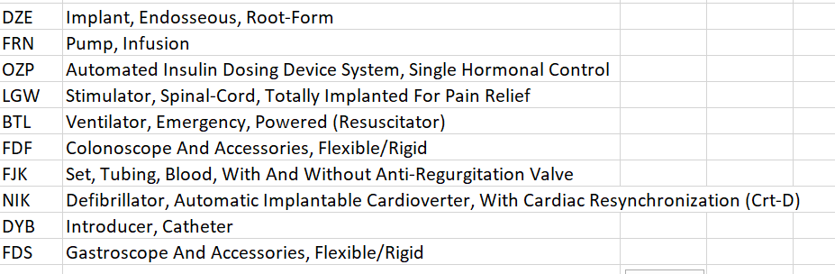

Slide 12
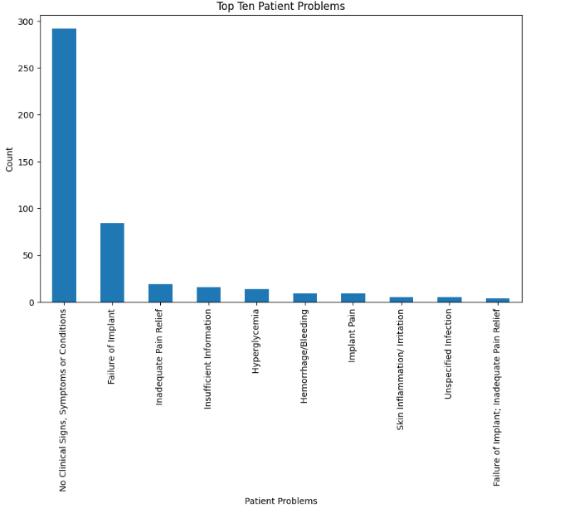

Slide 13
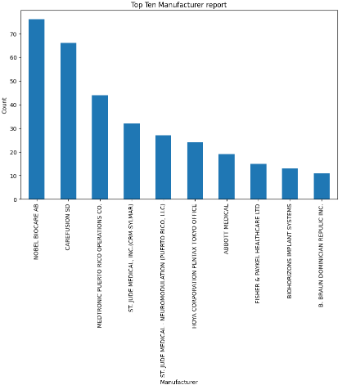

Slide 14
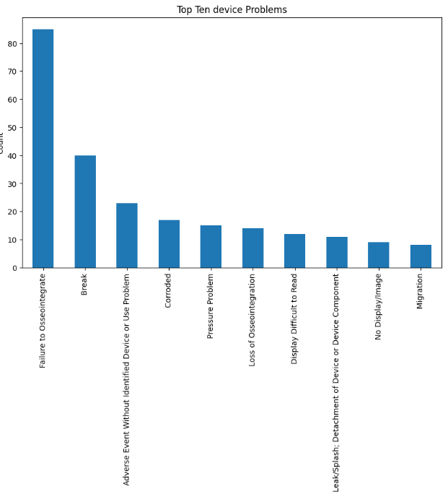

Slide 15
Results

Slide 16
Accuracy: 0.86
Precision: 0.87
Recall: 0.86

Slide 17
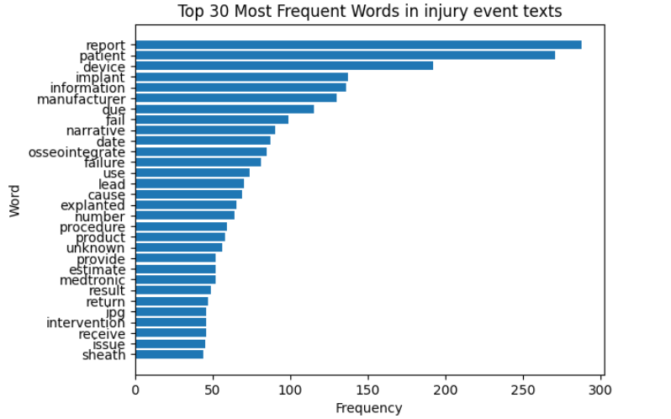

Slide 18
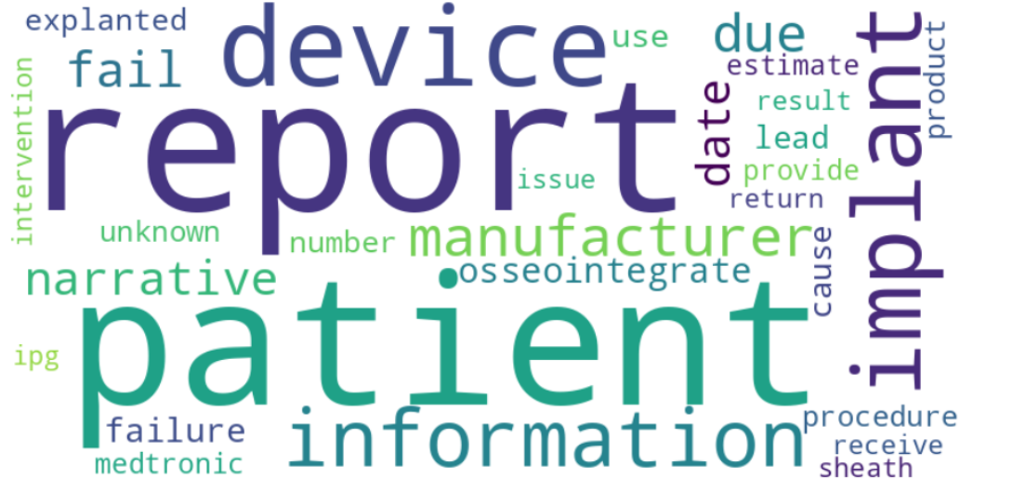
Word Cloud for Injury Group

Slide 19
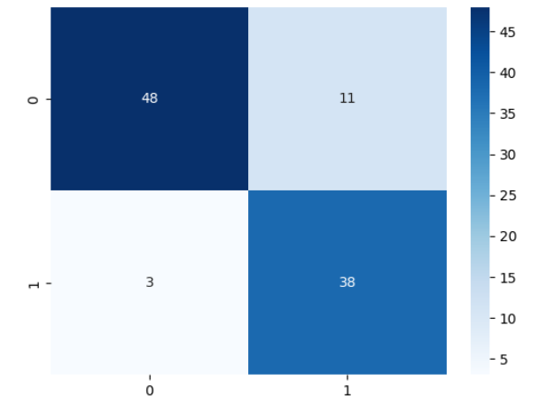
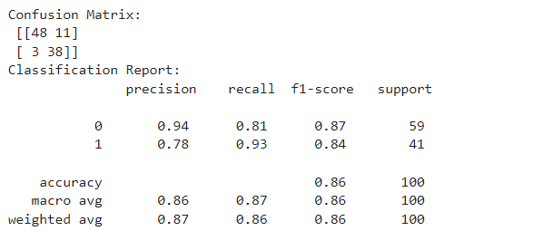

Slide 20
Limitations and Future Research

Slide 21
The cases in this study is only 500 records. Even though the accuracy is relatively good. I would like to see if adding more records will improve the accuracy.
Topic Modeling on most mentioned topics on the AE Report text for the injury group.

Slide 22
What I have tried

Slide 23
I have added some of the common words that might not be useful in predicting injury to the stop words and see if that improve the model.
The accuracy decreased slightly from .86 to .85.
Therefore, I reverted it back to the original model without removing those common words.
Maybe when there is injury, the AE text has mentioned “patient” and “report” more frequently, than when there is no injury.

Slide 24
References

Slide 25
Wang, L. et. al. (2022). Assessment of electronic health record for cancer research and patient care through a scoping review of cancer natural language processing. JCO Clinical Cancer Informatics 6.
https://ascopubs.org/doi/full/10.1200/CCI.22.00006
Ariwala, P. (Jun 15, 2023). Top 14 Use Cases of Natural Language Processing in Healthcare. Maruti Techlabs.
https://marutitech.com/use-cases-of-natural-language-processing-in-healthcare/
Ariwala, P. (Apr 3, 2023). Unlocking the Power of NLP in Healthcare: A Comprehensive Review. Maruti Techlabs.
https://marutitech.com/nlp-in-healthcare/

